Slide 1
I’CARE Store Management Software
Name Here

Slide 2
Features:
Quickly manage stocks.
Stores All the employees that are entered.
Only One User is needed.
Easy To Use.
Safe and Secure.

Slide 3
Drawbacks:
Console Application.
Only Administrator
No Error Execution.
Only Windows Supported

Slide 4
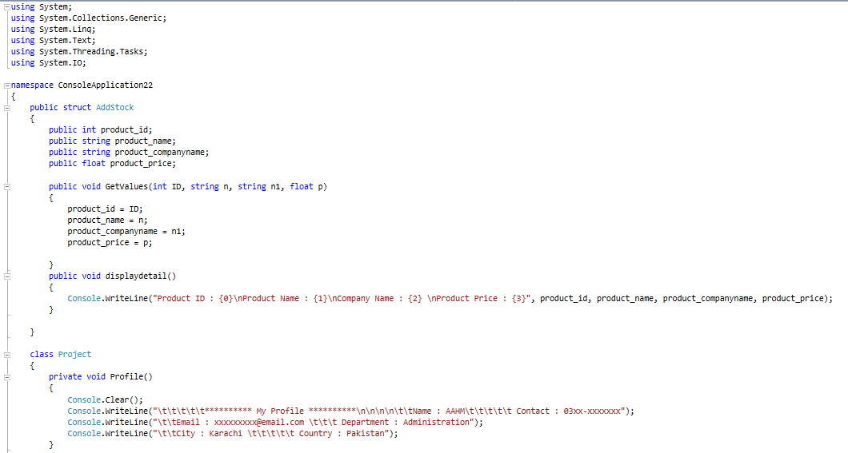
Code:

Slide 5
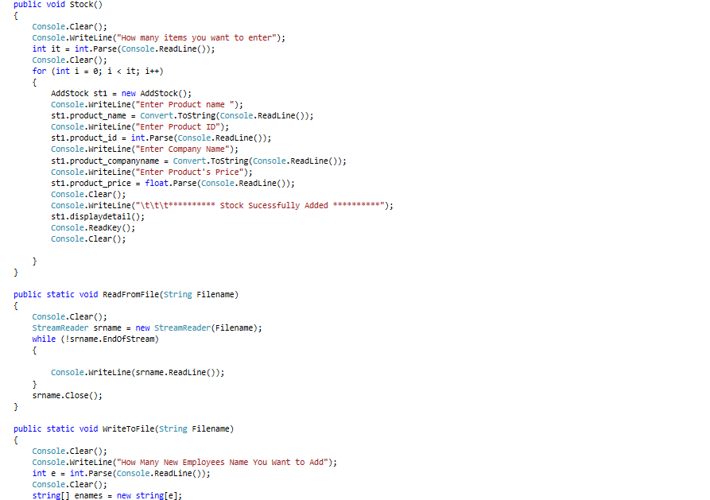
.

Slide 6
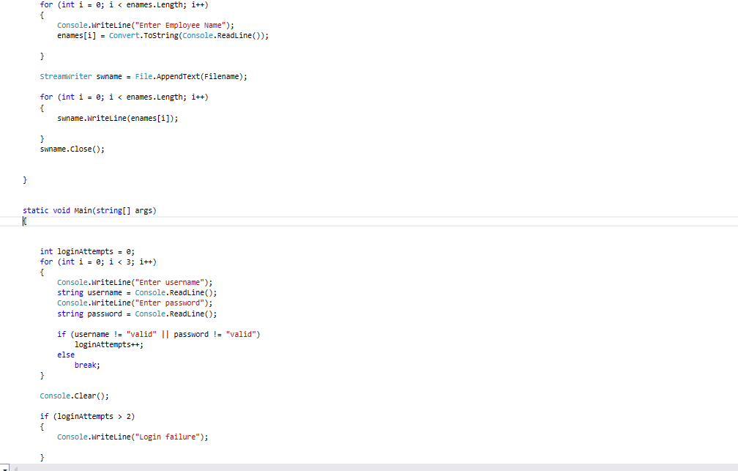
.

Slide 7
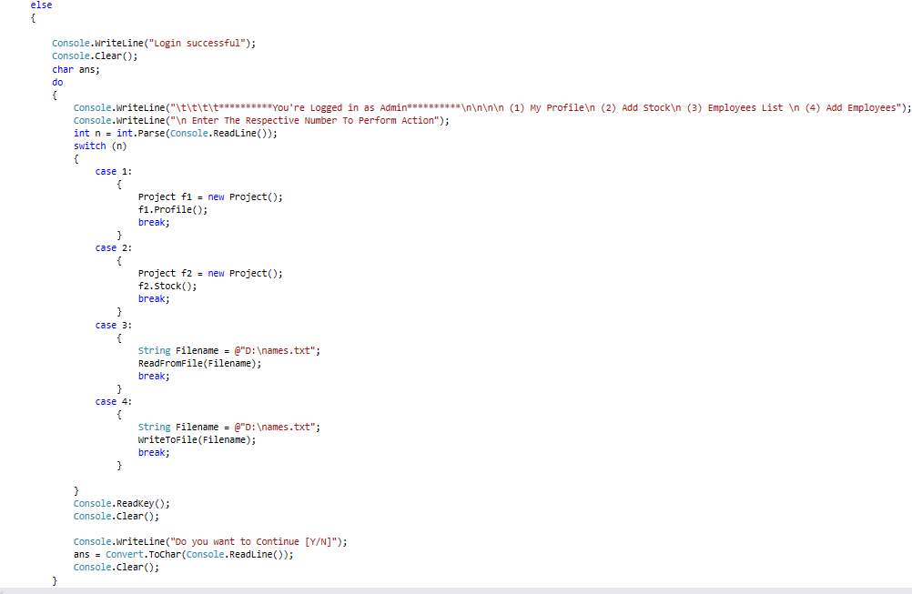
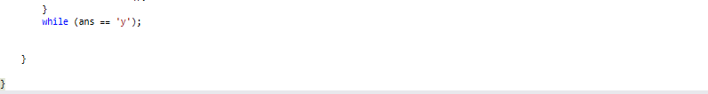
.

Slide 8
Workflow Diagram:
.

